Slide 1
Cancer Overview

Slide 2
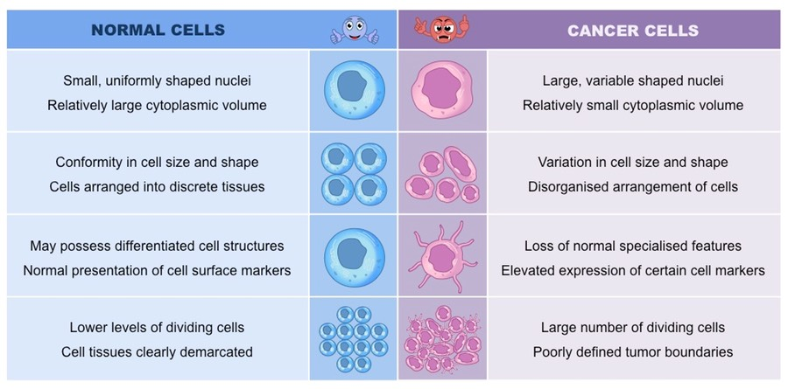
What is Cancer?
A group of diseases characterized by the uncontrolled growth and spread of abnormal cells that can result in death if not treated (American Cancer Society, 2021).

Slide 3
Prevalence
Cancer is the second leading cause of death in the United States
16.9 million Americans have history of a cancer diagnosis.
1. 9 million Americans are expected to be diagnosed in 2022.
80% of all cases are individuals 55 years and older
41 out of 100 men will develop cancer in the United States.
39 out of 100 women will develop cancer in the United States (American Cancer Society, 2022).
Notes:
26% of cases for men are prostate.
30% of cases for women is breast.

Slide 4
Cancer Statistics
Etiology
Smoking and Tobacco
Diet and Physical Activity
Sun and Other Types of Radiation
Viruses and Other Infections (American Cancer Society, 2022).
Risk Factors
Advanced age: 55 years and older
Risky behaviors and modifiable factors: smoking, increased body weight, drinking alcohol, and having unhealthy diet.
Family history and genetic susceptibility (American Cancer Society, 2021).
Notes:
Etiology: the cause, set of causes, or manner of causation of a disease or condition.
Risk Factors: Risk factors can be genetic or an aspect of personal behavior, lifestyle or environmental exposure.

Slide 5
Most Common Types of Cancer
Breast
Childhood and Adolescent Cancer
Colon and Rectum
Kidney and Renal Pelvis
Leukemia
Liver
Lung and Bronchus
Lymphoma
Oral Cavity and Pharynx
Ovary
Pancreas
Prostate
Skin
Thyroid
Uterine Cervix
Uterine Corpus (Endometrium)

Slide 6
Types of Treatment
Surgery
Chemotherapy
Radiation Therapy
Targeted Therapy
Immunotherapy
Stem Cell or Bone Marrow Transplant
Hormone Therapy
Notes:
Surgery: Surgery is used to prevent, diagnose, stage, and treat cancer. Surgery can also relieve (palliate) discomfort or problems related to cancer.
Chemotherapy: Traditional or standard chemotherapy uses drugs that are cytotoxic, meaning they can kill tumor cells.
Radiation Therapy: Radiation therapy uses high-energy particles or waves, such as x-rays, gamma rays, electron beams, or protons, to destroy or damage cancer cells.
Targeted therapy is a type of cancer treatment that uses drugs or other substances to precisely identify and attack certain types of cancer cells (Targeted drugs can block or turn off signals that make cancer cells grow, or can signal the cancer cells to destroy themselves.)
Immunotherapy treatment that uses a person's own immune system to fight cancer. Immunotherapy can boost or change how the immune system works so it can find and attack cancer cells.
Stem cell transplants are used to replace bone marrow cells that have been destroyed by cancer or destroyed by the chemo and/or radiation used to treat the cancer.
Hormone Therapy Some cancers depend on hormones to grow. Because of this, treatments that block or alter hormones can sometimes help slow or stop the growth of these cancers. (e.i. breast and prostate cancer)

Slide 7
Related Disorders
Anxiety
Balance problems and falling
Blood clots
Bowel and Bladder problems
Decreased cognitive ability
Confusion and delirium
Constipation
Dehydration
Depression
Diarrhea
Distress
Diet changes
Emotion and behavior changes
Fatigue and weakness
Fever
Hair loss
Hiccups
Heartburn
Hot flashes and sweating
Incontinence
Infections
Infusion and immune reactions
Leg cramps
Low blood count
Lymphedema
Mouth sores
Nail changes
Nauseas and vomiting
Peripheral neuropathy
Prostheses
Seizures
Shortness of breath
Skin problems

Slide 8
Impact on Occupation and Performance Skills
Motor skill:
Increased fatigue and pain associated with completing activities of daily living.
Processing skills:
Limited processing skills associated with illness and cancer related treatments.
Ability to adjust to having a life threating illness is often impaired.
Struggle with skills associated with accepting a cancer diagnosis and adapting to their new reality.
Lack the ability to choose and make executive decisions related to treatment.
Processing skills are highly impacted as individuals with a cancer diagnosis navigate the healing process of a life-threatening illness.
Social Skills:
Ability to express emotions and disclose information.
Reservations displaying and disclosing emotions that stem from having cancer.
Reduce their social participation, as a result of maladaptive thoughts and feelings associated with copying with having a terminal illness
Decreased expression of emotions to prevent further distress of caregivers.
Decreased social interaction to distract from emotions being internalized
Decreased ability to endure and pace through an activity.
Decreased ability to complete a task specific activity due to musculoskeletal pain and weakness.
Increased need to rest throughout the day

Slide 9
References
American Cancer Society (2021). Cancer Basics Retrieved from http://www.cancer.org/cancer/cancercauses/geneticsandcancer/index
Occupational Therapy Practice Framework: Domain and Process (3rd Edition). (2017, March 1). https://ajot.aota.org/article.aspx?articleid=1860439.
Pilegaard, M. S., la Cour, K., Gregersen Oestergaard, L., Johnsen, A. T., Lindahl-Jacobsen, L., Højris, I., & Brandt, Å. (2018). The “Cancer Home-Life Intervention”: A randomized controlled trial evaluating the efficacy of an occupational therapy--based intervention in people with advanced cancer. Palliative Medicine, 32(4), 744–756.
Mohammadi, A., Mehraban, A. H., & Damavandi, S. A. (2017). Effect of Play-based Occupational Therapy on Symptoms of Hospitalized Children with Cancer: A Single-subject Study. Asia-Pacific Journal of Oncology Nursing, 4(2), 168–172. https://doi-org.ezproxy.umary.edu/10.4103/apjon.apjon_13_17

